Slide 1
Chromatin occupancy analysis at hypermethylated regions
(hypermethylated regions called by J.Tobias)
Top 2000 sites
(individual CpG sites)
All Methylation sites called “Strongly Methylated”
n=16,249
n=10,556
Hypomethylated in CarT+
Hypermethylated in CarT+
Hypomethylated in CarT+
Hypermethylated in CarT+
ATAC Enrichment
(-/+50bp from CpG, log2)
ATAC Enrichment
(-/+50bp from CpG, log2)
CarT+
CarT-
CarT+
CarT-
CarT+
CarT+
CarT-
CarT-
Notes:
Taking the top 2000 hyper and hypomethylated regions in the genome (in this case, region= a single CpG), I asked whether we had more Open or closed chromatin in the surrounding 100bp (-/+50bp) from the CpG using ATAC-seq data.
As you can see, the top hypomethylated sites in CarT+ cells are more open than in CarT- cells.
Conversely (and the most mechanistically interesting), the CarT+ hypermethylated regions are much more closed.
This trend does not hold when we take all sites called as hypo or hypermethylated, but that’s not really unexpected.
OF NOTE: we need to look at the best set of Hypermethylated and closed in CarT+. There are going to be some very very closed regions that are also hypermethylated and those might be the most interesting. Not the middling ones…This is ongoing.

Slide 2
Global DNA methylation Summary
CpG | # | %
Strongly Hypermethylated in CarT+ | 10557 | 0.409821269
Hypermethylated in CarT+ | 59076 | 2.293322091
Insignificant | 2426384 | 94.1918889
Strongly Hypomethylated in CarT+ | 63734 | 2.474145002
Strongly Hypomethylated in CarT+ | 16250 | 0.630822736
Total | 2576001
CHH | # | %
Hypermethylated in CarT+ | 1518 | 0.014309237
Insignificant | 10602697 | 99.9449971
Hypomethylated in CarT+ | 4317 | 0.040693661
Total | 10608532
CHG | # | %
Hypermethylated in CarT+ | 747 | 0.016573799
Insignificant | 4504499 | 99.94198061
Hypomethylated in CarT+ | 1868 | 0.04144559
Total | 4507114
Notes:
In summary, we have about 6% of the CpG’s in the genome that have some level of significance. I used all of these CpG’s (both strongly and “regular” methylated) to perform CpG stitching.

Slide 3
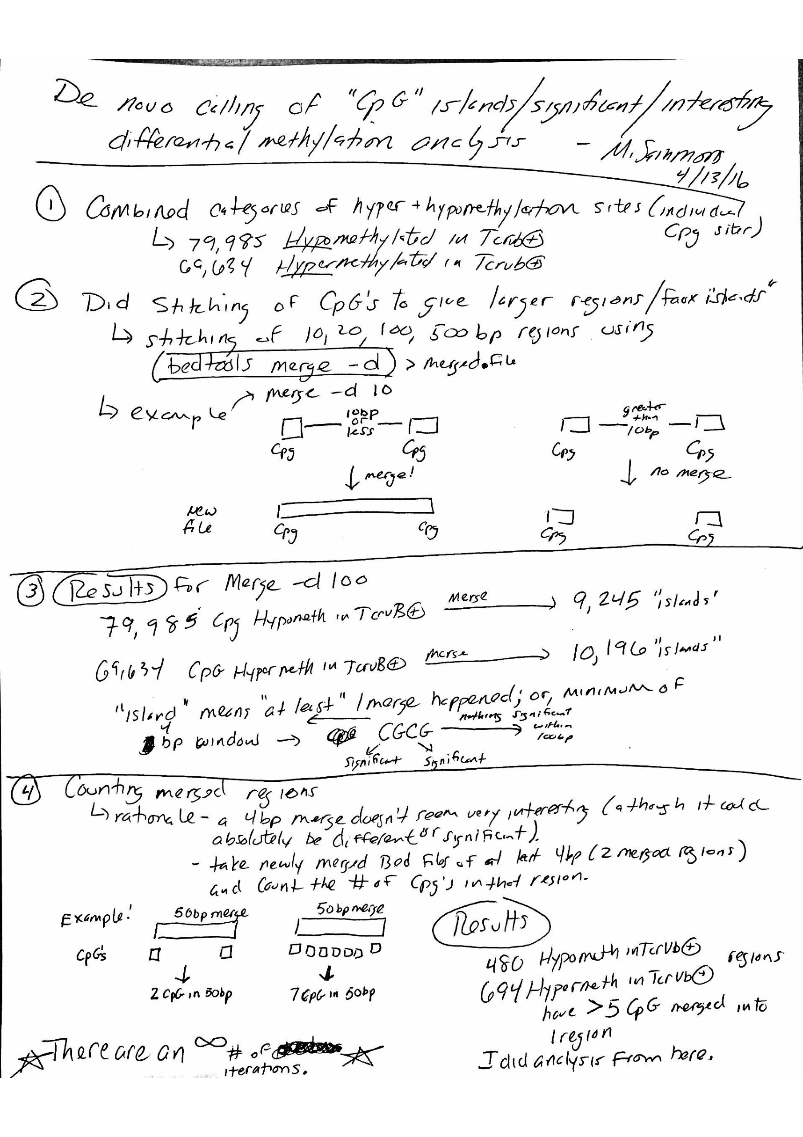
Creating our own CpG islands
See attached document for better view.
Notes:
This file is also included. It’s just what I did to perform methyl stitchng.

Slide 4
Methylation merge statistics and intersection with ATAC regions
Name of File | # of CpGs
Hypermethylated Regions | 79984
10 bp merge | 72246
20 bp merge | 69854
100 bp merge | 64877
500 bp merge | 58264
Name of File | # of CpGs
Hypomethylated Regions | 69633
10 bp merge | 61423
20 bp merge | 58990
100 bp merge | 54108
500 bp merge | 47903
 | 500 bp Merged CpG Islands
 | Hypermethylated in TCR- | Hypomethylated in TCR-
ATAC Downregulated in TCR- | 461 (7.7%) | 524 (8.7%)
ATAC Upregulated in TCR- | 88 (2.6%) | 108 (3.2%)
Strongly hyp(o/er)methylated and hyp(o/er)methylated sites were both considered.

Slide 5
Methylation merge statistics for strongly methylated regions and intersection with ATAC
Name of File | # of CpGs
All Hyper | 16250
10 bp merge | 15027
50 bp merge | 14362
100 bp merge | 14215
500 bp merge | 13748
Name of File | # of CpGs
All Hypo | 10557
10 bp merge | 9336
50 bp merge | 8665
100 bp merge | 8497
500 bp merge | 7942
 | Stitched 500bp StrongMethylation Only
 | StrongHypermeth in TCR- | StrongHypoMeth in TCR-
ATAC Down in TCR- | 82 (1.4%) | 131 (2.2%)
ATAC Up in TCR- | 16 (0.47%) | 33 (0.98%)
Important observation: The large majority of “CpG islands” are lone CpG methylation sites, which suggests there are very few real differentially methylated “CpG islands” as we classically understand them

Slide 6
ATAC enrichment at differentially methylated CpG islands
Hypermethylated in TCR-
Hypomethylated in TCR-
ATAC-enrichment (log2)
ATAC-enrichment (log2)
TCR- Rep1
TCR+ Rep1
TCR- Rep1
TCR- Rep2
TCR+ Rep2
TCR+ Rep1
TCR- Rep2
TCR+ Rep2
These CpG islands are stitched 500bp regions that contain at least 5 differentially methylated CpG calls

Slide 7
Gene ontology for Hypomethylated CpG islands in CarT+
Notes:
Nothing jumps out at me as being particularly interesting. Not surprising that we have a lot of developmental-type categories, as DNA methylation normally occurs at these types of genes to shut them off after development and during lineage differentiation

Slide 8
Gene ontology for Hypermethylated CpG in CarT+
Notes:
Nothing jumps out at me as being particularly interesting. Not surprising that we have a lot of developmental-type categories, as DNA methylation normally occurs at these types of genes to shut them off after development and during lineage differentiation

Slide 9
Genomewide ATAC correlation
TAG-min | TCR- Rep1 | 1
GGA-min | TCR- Rep2 | 0.99986 | 1
CTC-plus | TCR+ Rep1 | 0.99916 | 0.99345 | 1
CAG-plus | TCR+ Rep2 | 0.99796 | 0.99841 | 0.99947 | 1
 |  | TCR- Rep1 | TCR- Rep2 | TCR+ Rep1 | TCR+ Rep2
 |  | TAG-min | GGA-min | CTC-plus | CAG-plus

Slide 10
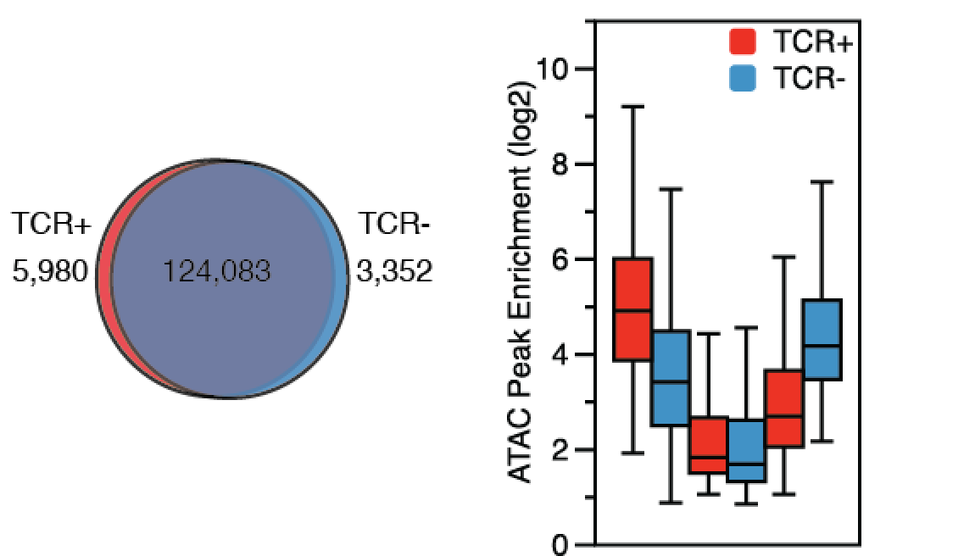
Enrichment of ATAC peak differences

Slide 11
More open in TCR- by ATAC

Slide 12
More open in TCR+ by ATAC

Slide 13
ATAC-seq enrichment at ATAC-seq peaks that intersect Methylation regions
Hypomethylated in TCR-
Hypermethylated in TCR-
N=5646
N=4881
ATAC_Enrichment (log2)
TCR+ | TCR-
TCR+ | TCR-

Slide 14
Bach2-containing peaks More enriched in CarT-

Slide 15
Bach2-containing peaks more enriched in CarT+

Slide 16
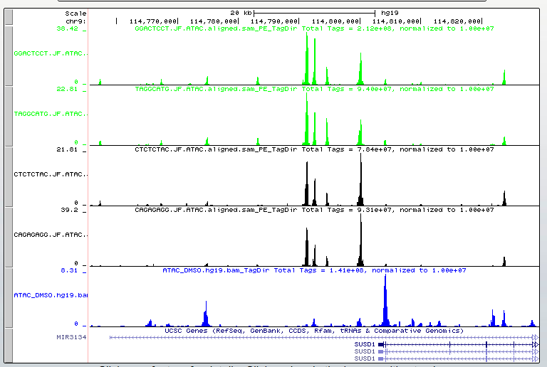
MACS- Top enriched site in CarT- vs CarT+

Slide 17
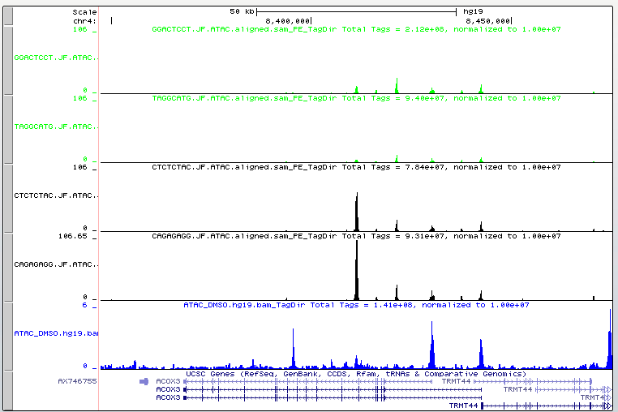
MACS- Top enriched site in CarT+ vs CarT-

Slide 18
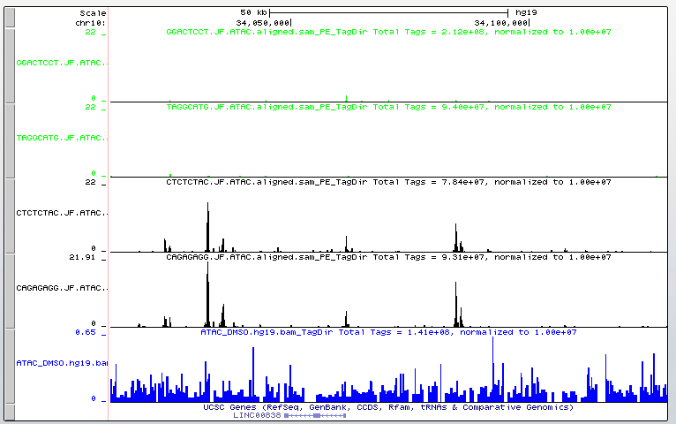
HOMER- Top enriched site in CarT+ vs CarT-

Slide 19
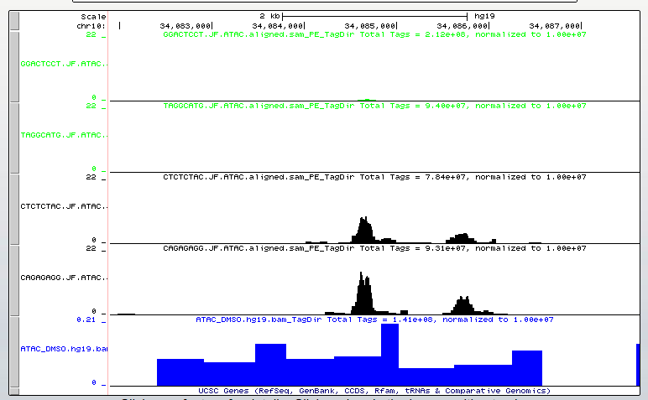

Slide 20
Comparing ATAC-seq and DNA methylation with functional gene lists
ATAC-seq
DNA methylation
More Open CarT+ | More Closed CarT+
EOMES | IL2RA
 | CCR4
 | PRDM1
 | IL1RN
 | PTPRC
 | CCR7
 | EOMES
 | CTLA4
 | LAG3
 | IFNG
 | IL13
Hypomethylated | Hypermethylated
 | EOMES
Notes:
Taking the list of genes/proteins that have been functionally tested in at least one way, I asked whether there were any significant ATAC-seq or DNA methylation regions near or within these targets. So in this case, it’s not asking whether we have more or less DNA methylation or open chromatin over the entire gene, but rather if a significant region was found near these genes.
As you can see, there are quite a few ATAC seq peaks that are more closed in CarT+ cells that overlap with some of these functional genes. Hopefully they are acting as expected.
Conversely, there are no significant DNA methylation regions (including the stitched methylation regions) near these functional genes.

Slide 21
Overlap between genes with significant ATAC and DNA methylation
Hypo and More Open | Hypo and More Closed
MCM10 | INSIG1
LINC00221 | OR1F1
NUPL1 | LINC01257
CST7 | ZC3H12D
CTU1 | LOC728613
CYTH2 | MCOLN2
EGLN3 | WT1
CAMTA1 | LRRFIP1
8/783 | ARHGEF3
 | LDLRAD4
 | WWTR1
 | RUNX1
 | BHLHE40
 | CD2
 | KIF5C
 | COPS8
 | FGF12
 | KLF13
 | GLRX3
 | SNORA14B
 | RUNX2
 | TNS3
 | 22/1222
Hyper and More Open | Hyper and More Closed
SPRY2 | KLF10
PITRM1 | LDLRAD4
CCDC174 | ITGB1
ITGB1 | NBPF25P
ARHGAP22 | GCNT4
KIZ | NCK2
RNU6-16P | PTPRG
LINC00461 | TLDC1
PRSS8 | PRDM14
TLDC1 | G0S2
L3MBTL1 | SAMD5
EGR4 | PTPN14
TRPS1 | ITGA2
ITGA2 | PPP1R3G
TEF | NLRP6
SOGA1 | TRIM36
EPHB1 | CD226
CRB2 | NFATC2
LOC100507316 | EHD1
PRDM13 | GPR132
EOMES | KANK3
RPLP1 | EOMES
RAET1K | PPP2R5C
23/783 | DUSP4
 | INPP4B
 | 25/1222
Notes:
What are the genes that have ATAC peaks (either more open or more closed) and then also have a differentially regulated DNA methylation site near the same gene.
This does not mean the ATAC and DNA methylation overlap each other, just the genes have both a DNA and ATAC site.

Slide 22
Peak width distribution
Peak width in bp
MACS
HOMER

Slide 23
Peak enrichment overlap
CarT+
CarT-
CarT+
CarT-
5,980
124,083
3,352
8,187
64,020
3,049
MACS
HOMER

Slide 24
ATAC-seq at GAPDH
CarT-
CarT+
Fibro
Notes:
Genome browser track of the GAPDH loci (approximately 300kB total).
Scales are obviously different, but that’s ok. The pattern is the main thing to look at for ATAC-seq. We account for the scale when actually quantifying.

Slide 25
ATAC-seq at PDCD1
CarT-
CarT+
Fibro
Notes:
Track view at

Slide 26
ATAC-seq at TET2
CarT-
CarT+
Fibro
Notes:
Track view for TET2 (Shelley, ask them EXACTLY where the insertion is.)

Slide 27
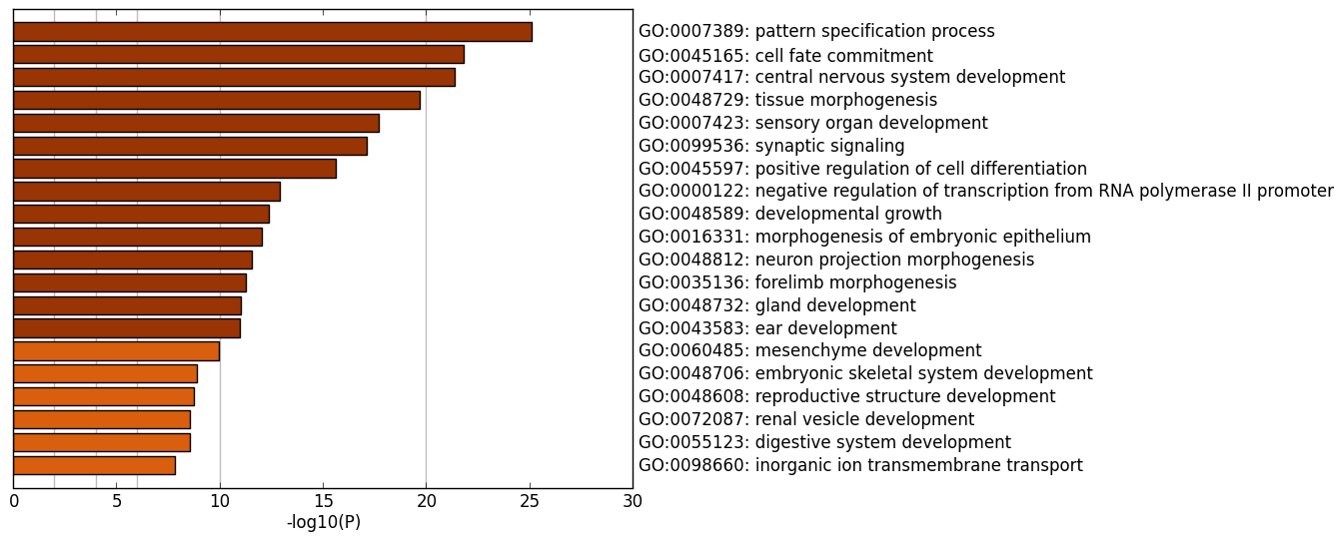
Gene ontology analysis for Top 2000 Hypermethylated sites in CarT+ cells
(based on DNA methylation analysis by J. Tobias)
Notes:
Using gene ontology for the top 2000 hypermethylated sites in CarT+ (agnostic of ATAC), we can see a number of significant GO terms, but nothing that leaps out as directly related to T cell function.

Slide 28
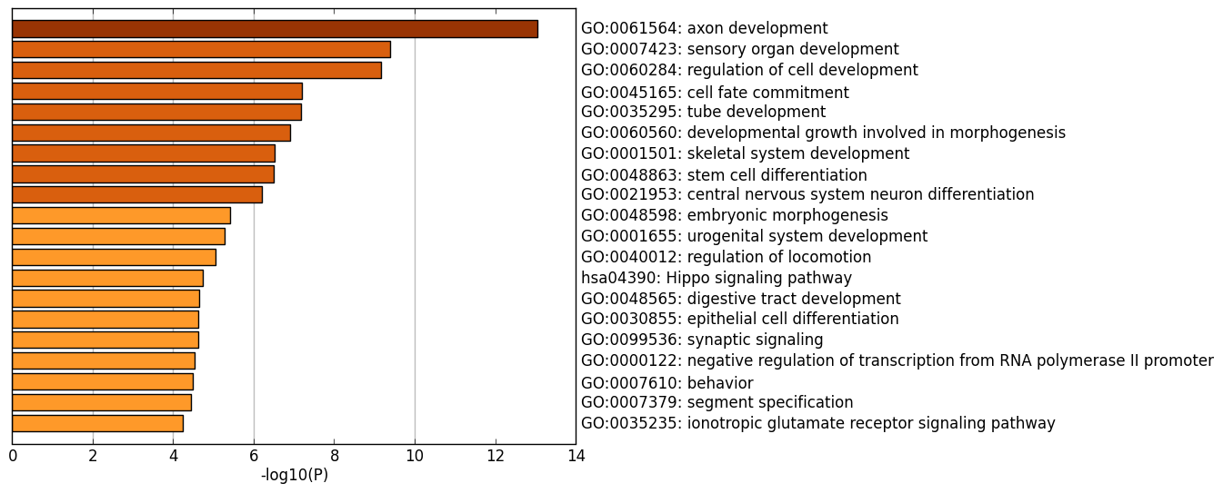
Gene ontology analysis for Top 2000 Hypomethylated sites in CarT+ cells
(based on DNA methylation analysis by J. Tobias)
Notes:
Using gene ontology for the top 2000 hypomethylated sites in CarT+ (agnostic of ATAC), we can see a number of significant GO terms, but nothing that leaps out as directly related to T cell function.

Slide 29
Bach2 Motifs within peaks from Original Dataset

Slide 30
Gene Ontology analysis of Bach2-containing peaks MORE closed in CarT+
 | 100bp | Entire Peak
More Open in CarT+ | 9/817 | 85/817
More Closed in CarT+ | 37/1549 | 375/1549

Slide 31
Bach2-containing peaks more open in CarT+

